Slide 1


7th Annual Conference of APS-HRMNet
«Local Africa Go Digital & Smart»
Tuesday 23 November, 2021
« Together for an Effective Local Africa »
Dr Najat Zarrouk, Director of Development, Capacity Building, Knowledge Management and ALGA Academy of UCLG Africa
www.uclga.org / www.uclgafrica-alga.org

Slide 2
CONTENT
I | Who We are ?
II | Our Vision & Mandate
III | UCLG Africa engaged and connected in times of Covid-19
IV | Lessons learned
V | A New Challenge and Deal for UCLG-Africa: Building and Anchoring a Digital and Smart Panafrican Organization
VI- | How We Are Laying the Milestones for this New Vision & Deal ?

Slide 3
I. Who We Are ?
Creation
2005
UCLG Regional Section in Africa
Headquarters in Morocco/Rabat
A Gathering of 54 NALAs + Several specific Networks
A Triennal Flagship Event
AFRICITIES
Sponsored by Morocco, European Commission + Members’s fees
U
C
L
G
-
A
F
R
I
C
A

Slide 4
II. Our Vision & Mandate
#CIBmeets2020
Anchoring Quality & Standards of Excellence
Building Africa Unity from its Grass Roots
Leaving no one, no place behind in Local Africa
Connecting People & Institutions
Working in Win-Win Partnerships & Co-Creation
Promoting Decentralization and Local Governance
Empowering
Human Capital
Diverse Methodology: advocacy, technical assistance, training, peer-learning, capacity building, knowledge sharing, Networking, Access to funding…..
Promoting Performance & Professionalism
at African Local Level

Slide 5





III- UCLG Africa, engaged and connected in times of Covid-19 Pandemic
Organizing, in house and online Coaching Sessions, on online Plateforms to empower UCLG-Africa Members, Networks, and Staff.
Using diverse plateforms (Zoom, Microsoft Teams, Social Medias…).
Moving from F2F to online and blended activities.
Several events organized and planned in time of Covid-19: statutory meetings, trainings, forums, conferences, side events….
Sharing informations on online activities: Webinars, MOOCs, Virtual events…
Participating to Partners online activities.
Learning to work Remotly for our Staff….

Slide 6
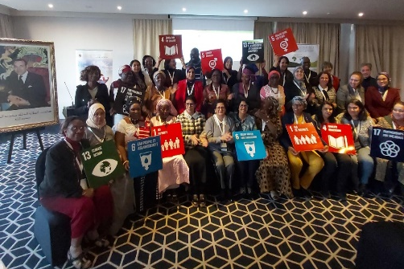
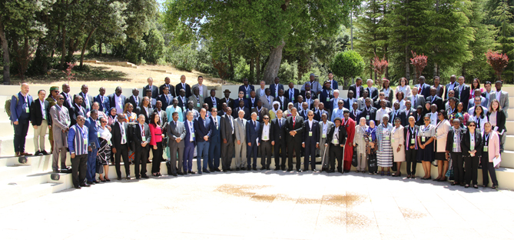
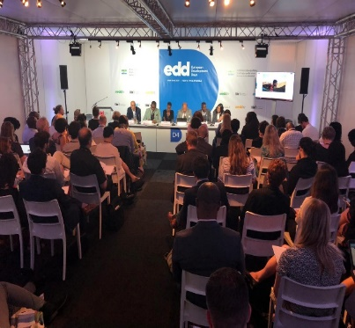
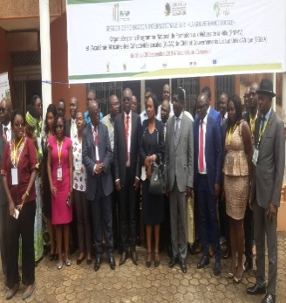
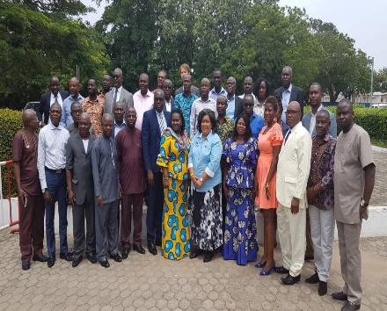
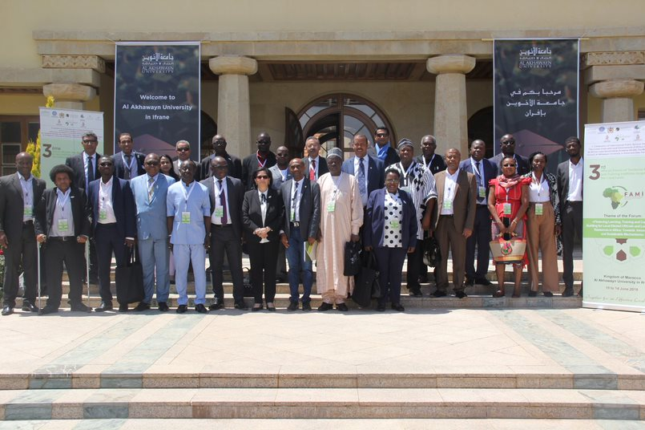
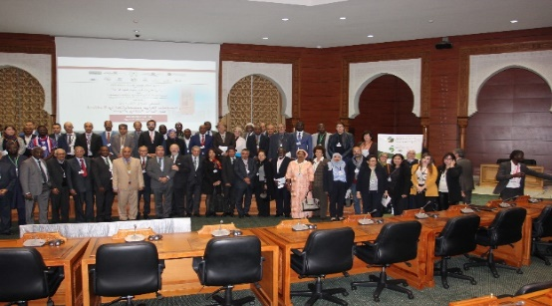
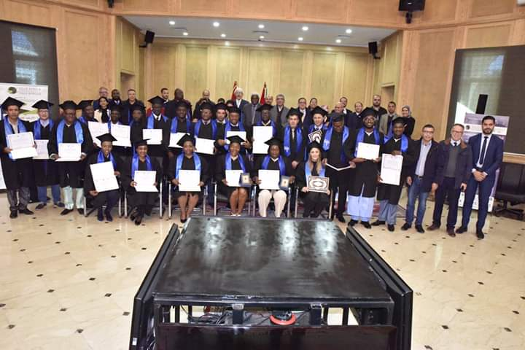
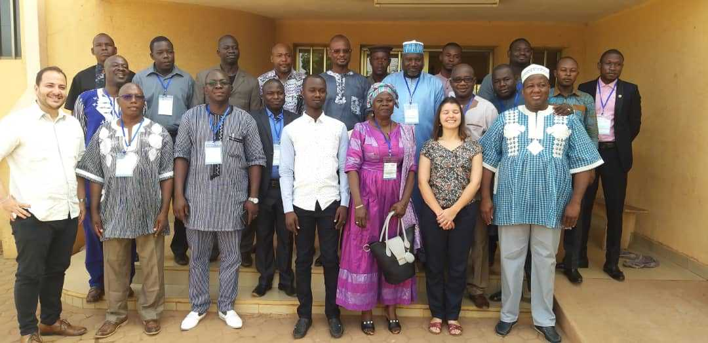
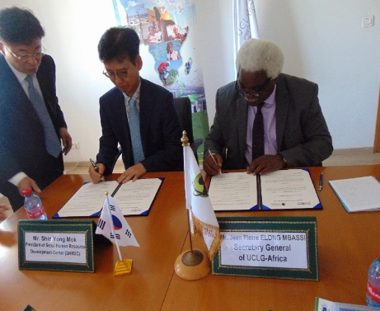
This how We were before the Pandemic of the Covid-19: 100% F2F
#CIBmeets2020

Slide 7
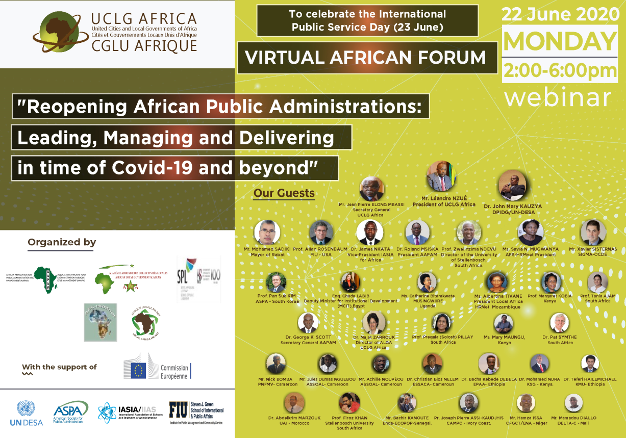
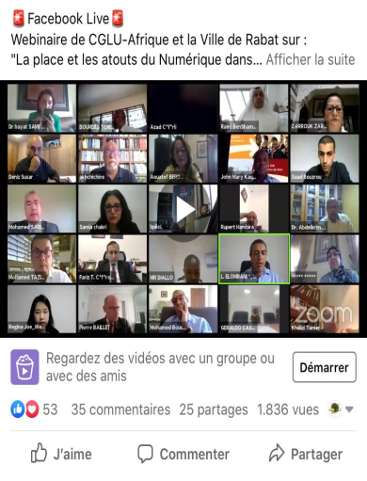
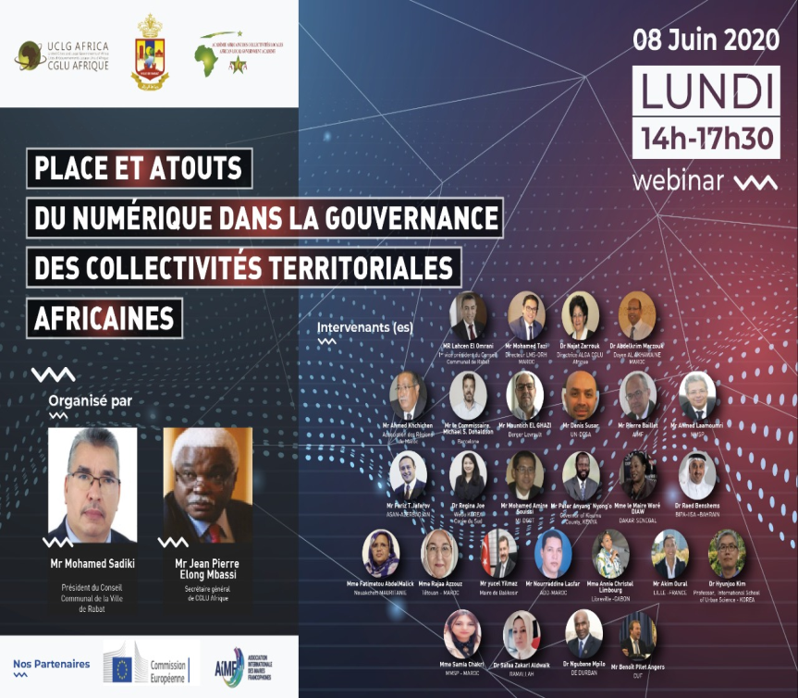
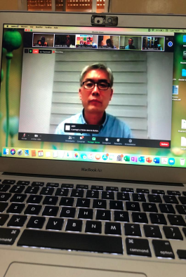
And this how be become since March 2020 to date…………
#CIBmeets2020
+30.000 participants/followers since the end of March until today….

Slide 8
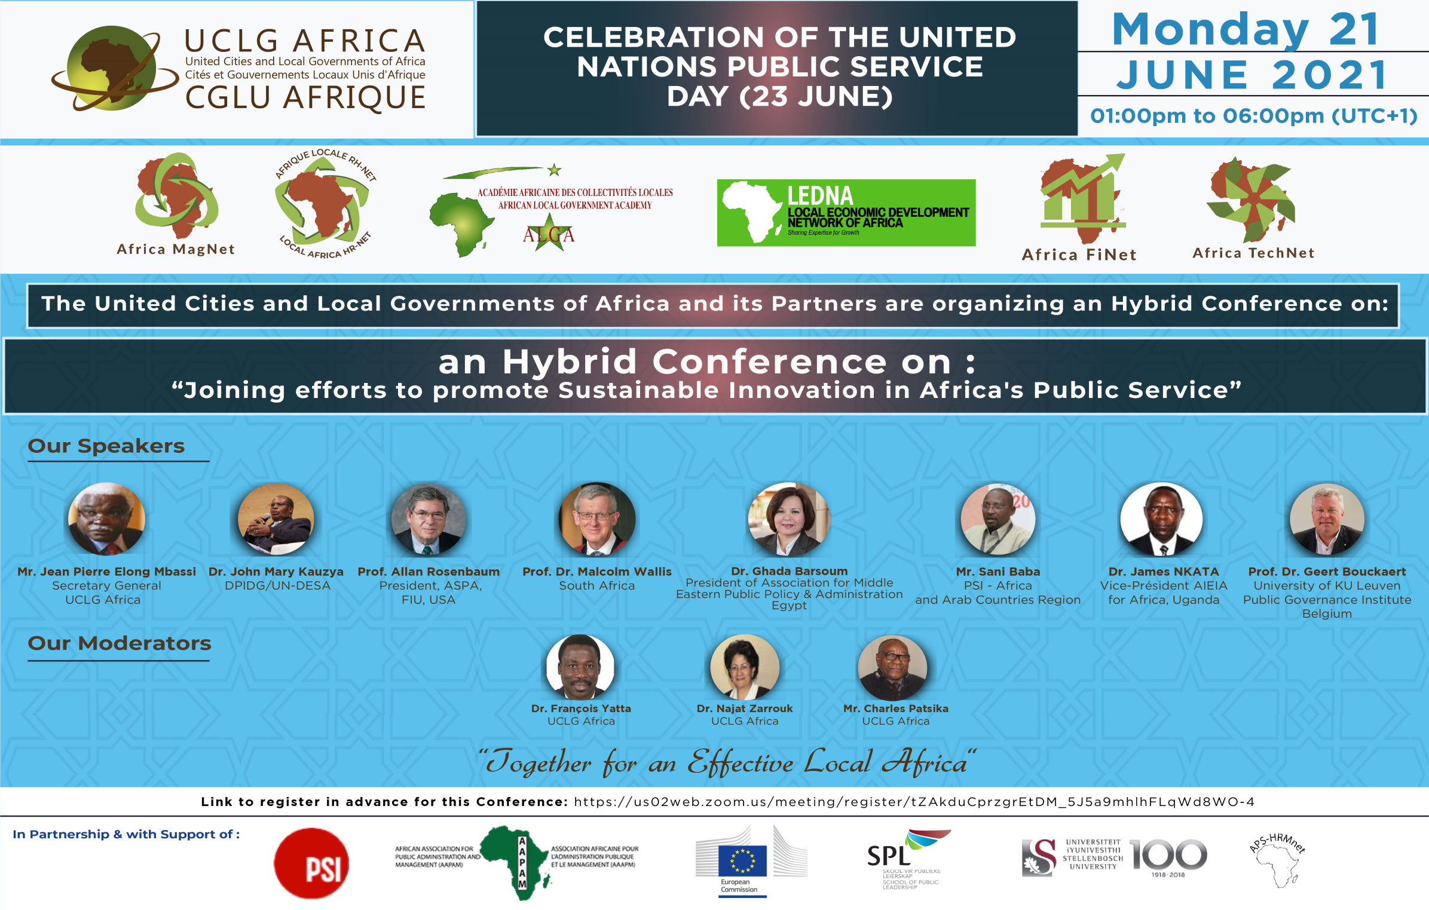

Slide 9

IV- Lessons learned
The uncertainty that surrounds the Post-Covid-19 : How to plan ? How to reach our Target groups ? How to mobilize ?
Maybe training, learning, capacity buidling are no longer among the priorities of Governments, Local Governments, International Organizations and Donors.
Our Obligation and Duty to stay connected in the Global Village.
The Digital Gap/Divide is an obvious reality at African Local Level, with serious problem of connexions to Internet, lack of devices….
With online activities, we can do more with less in terms of financial resources and time consuming.
We can reach more beneficiaries.
We reduce risks, travel constraints, challenges: costs, visa issue, bagages lost, language barriers….
We challenge borders.
We fight and reduce bureaucracy and « red tape » and improve transparency (hidden figures whom we can see and mobilize now).
We gain more Visibility globally….

Slide 10
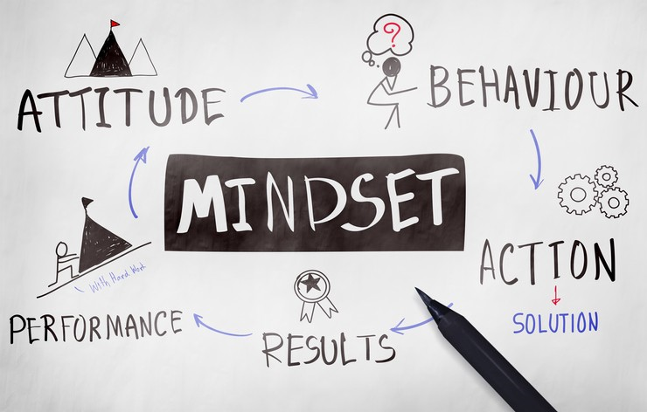
There’s a need of changing Mindset.
The political Will is key.
We always keep in mind that F2F activities provide a richer, human, more targeted, and more focused learning experience than nearly any virtual meeting.
Mobilizing fundings is a crucial issue.
We need to invest in Multi-Actors Partnerships in the spirit of SDG17.
We need to learn from Champions and build on best practices/Case studies to not reinvent the wheel!
We need to advocate for an Enabler environment and eco-system for the Digital and Smart Cities, based on Solidarity, Partnership, Cooperation, Co-Creation, Knowledge and Experience Sharing, with more integration and coherence.

Slide 11

V- A New Challenge and Deal for UCLG-Africa: Building a Digital & Smart Panafrican Organization …
In order to allow UCLG-Africa to adapt itself to this new challenging and unprecedent context;
To stay at the service of its Members and Networks;
To meet the Global and African Agendas;
To continue its activities and service offers;
To meet the 5 Priorities of EU, in particular the Digital Deal;
To rebuild better and in a Sustainable & Resilient way….
We decided to take advantage of the multiple opportunities offered by Information and Communication Technologies (ICTs), to Go Digital
to become a
“A Digital and Smart Panafrican Organization”

Slide 12
VI- How We Are Laying the Milestones for this New Vision & Deal ?
E-Academy with a New Digital Training Offer
www.uclga-e-academy.com
Online activities:
Webinars, MOOCs, Online Master Degree in City Management
Multi-Actors/Stakeholders Partnerships
Empowering Human Capital at Subnational Level in Africa
Need Assessments
01 Talent Africa Initiative
Empowering African Youth in Partnership with 01 Edu
Target: 500.000 elite software Coders to transform Digital Education System
www.01-edu.org
Dissemination of IEEE Survey on Smart Cities in Africa
Our Annual Hybrid Forum FAMI
dedicated to Digital and Smart Transformation
6-11/12/2021
www.uclgafrica-alga.org
Data Collection

Slide 13
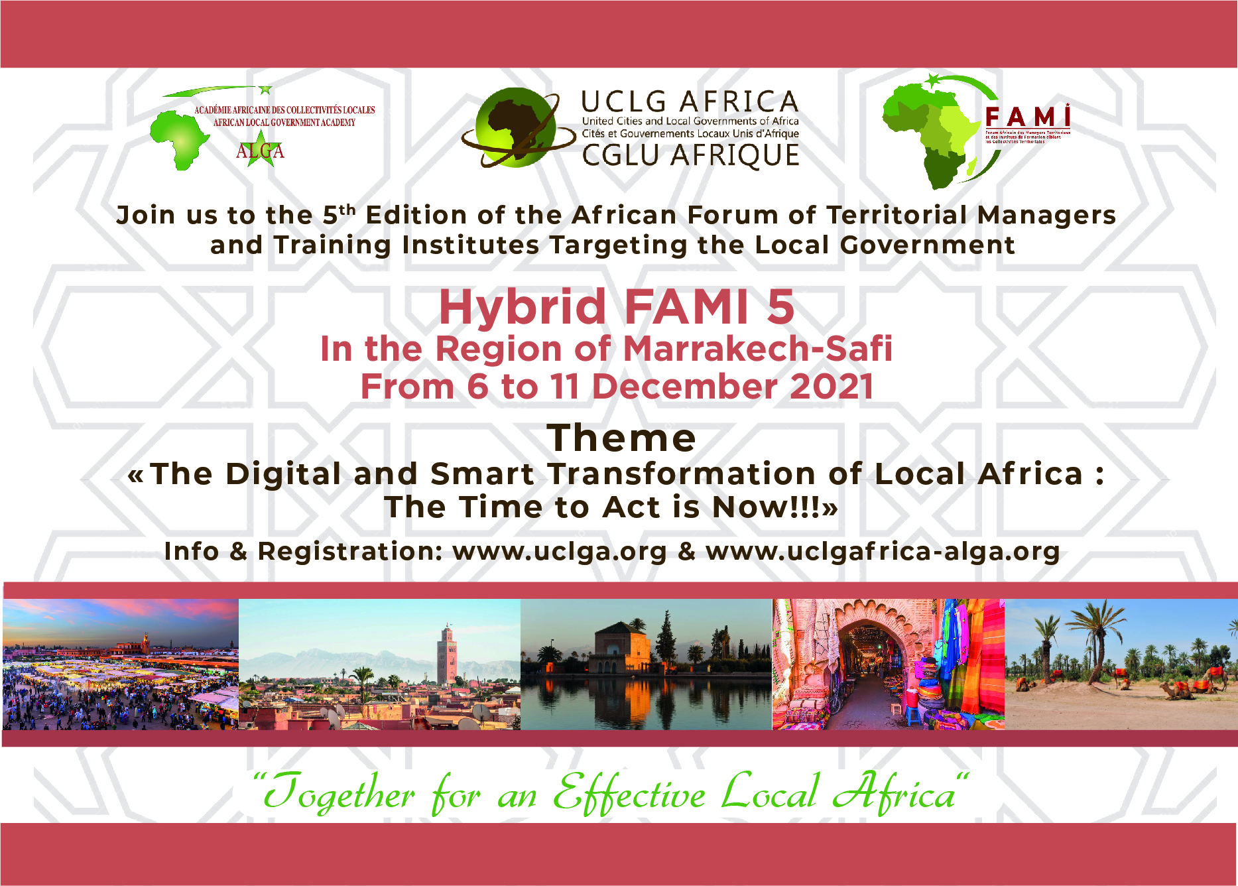

Slide 14

شكــــرا جــــزيلا
www.cglua.org www.uclga.org www.uclgafrica-alga.org

