Slide 1
2021 Conference International Association of Schools and Institutes of Administration -- IASIA-IIAS
Digital Transformation in Public Sector Institutions in Africa
Arpine Korekyan
Governance and Public Administration Officer, DPIDG/UNDESA
Hosted remotely by 7th Annual APS-HRMnet Conference in Kampala, Uganda, 23-25 November 2021

Slide 2
SDGs and Public Service Delivery
Innovation and public service delivery as key pillars for development
Out of 17 SDGs - 13 Goals have content related to public service delivery
Among 169 SDG targets 59 (35%) relate to public service delivery.
Among 230 indicators 66 (29%) require some specific public service to be delivered by public insitutions

Slide 3
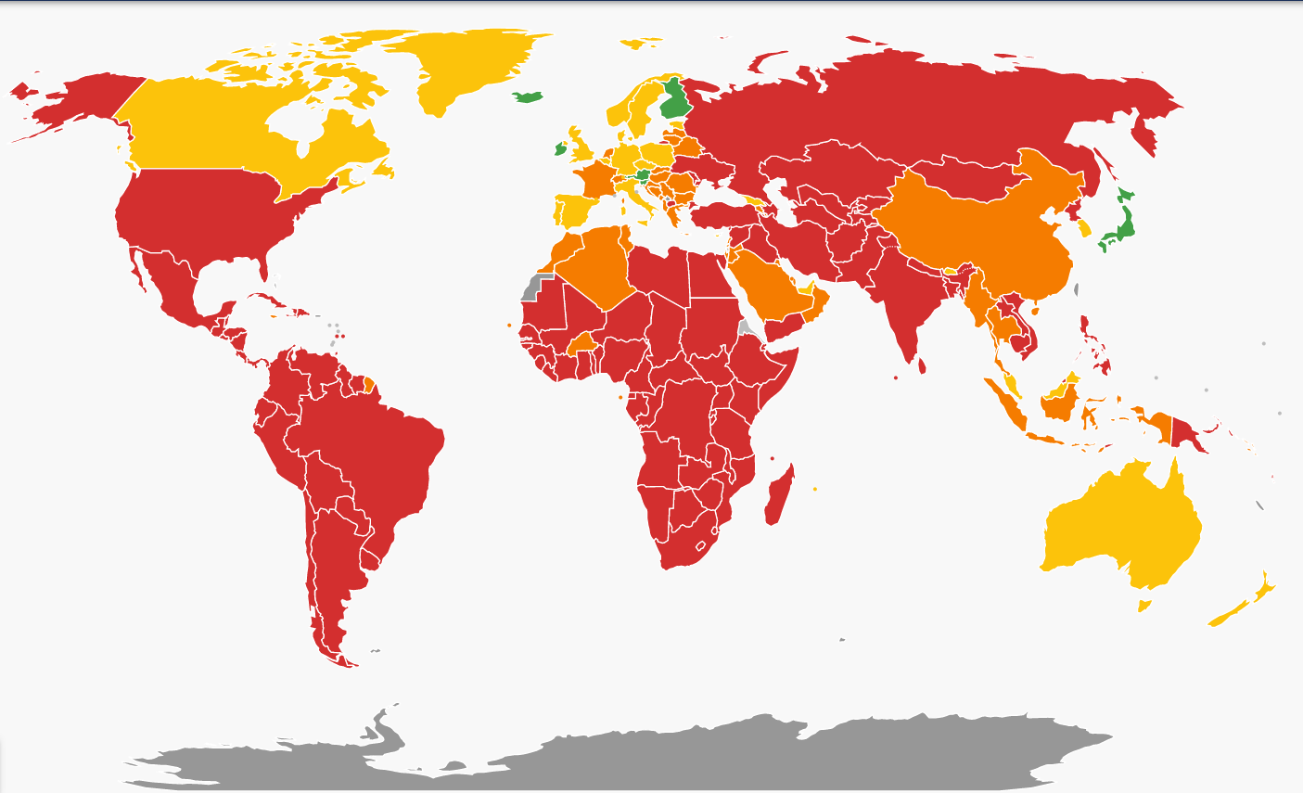
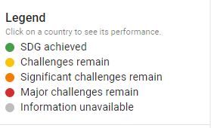
2030 Agenda for Sustainable Development
16.6 Develop effective, accountable and transparent institutions at all levels
16.7 Ensure responsive, inclusive, participatory and representative decision-making at all levels
16.8 Broaden and strengthen the participation of developing countries in the institutions of global governance
16.10 Ensure public access to information and protect fundamental freedoms, in accordance with national legislation and international agreements
2020 data
https://dashboards.sdgindex.org/

Slide 4
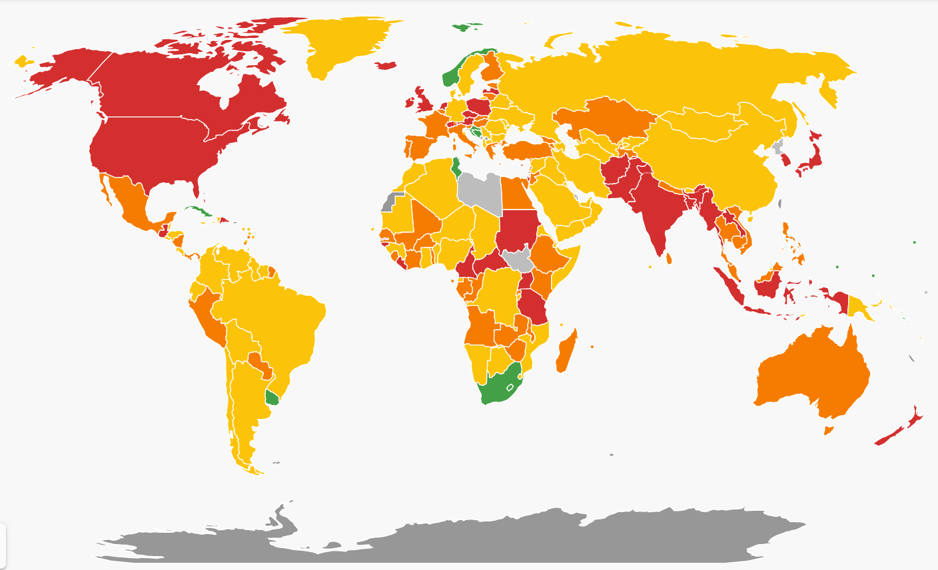
2030 Agenda for Sustainable Development
17.18 By 2020, enhance capacity-building support to developing countries, including for least developed countries and small island developing States, to increase significantly the availability of high-quality, timely and reliable data disaggregated by income, gender, age, race, ethnicity, migratory status, disability, geographic location and other characteristics relevant in national contexts
2020 data
https://dashboards.sdgindex.org/

Slide 5
“Digital solutions are transforming lives and can turbocharge our work to achieve the Sustainable Development Goals.” Internet Governance Forum 2018
Digital government supports the Decade of Action through sustainable, inclusive and equitable public service provision for all people everywhere, leaving no one behind—and more broadly through its growing role in driving innovation, strengthening efficacy, and generating solutions.

Slide 6
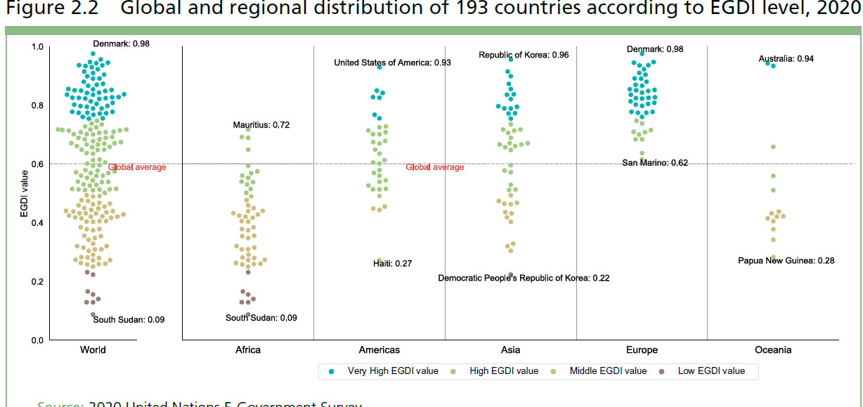
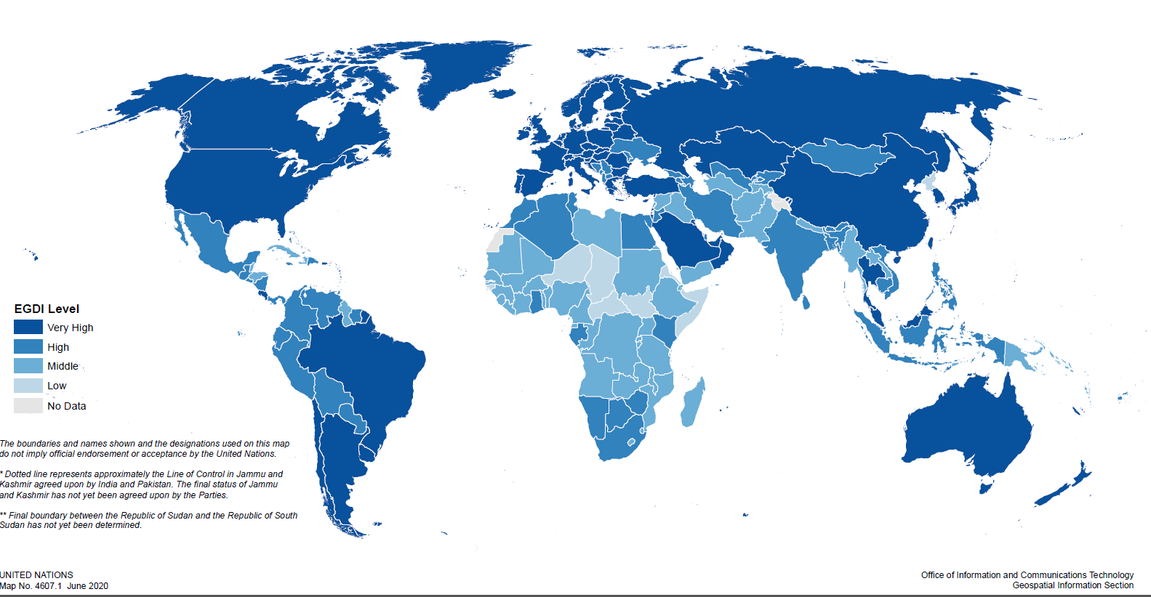
E-Government Development at a Glance
Key Messages
The Global average EGDI increased to 0.60 in 2020, from 0.55 in 2018
126 (65%) UN Member States have High and Very-High EGDI levels
57 countries have “Very-High EGDI” compared to 40 countries in 2018
Only 8 countries have “Low-EGDI” compared to 16 countries in 2018
Denmark is leading the global EGDI Ranking
ROK is leading in online service provision
Estonia has the most significant ascend since 2018
Notes:
Global trends in e-government development improved

Slide 7
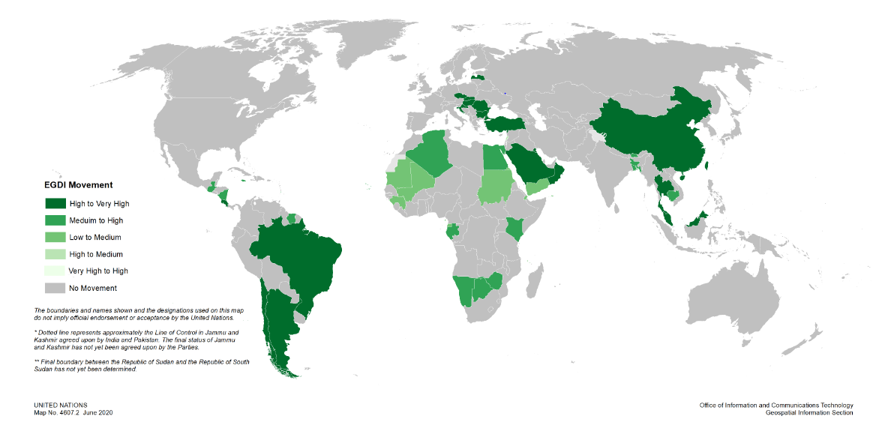
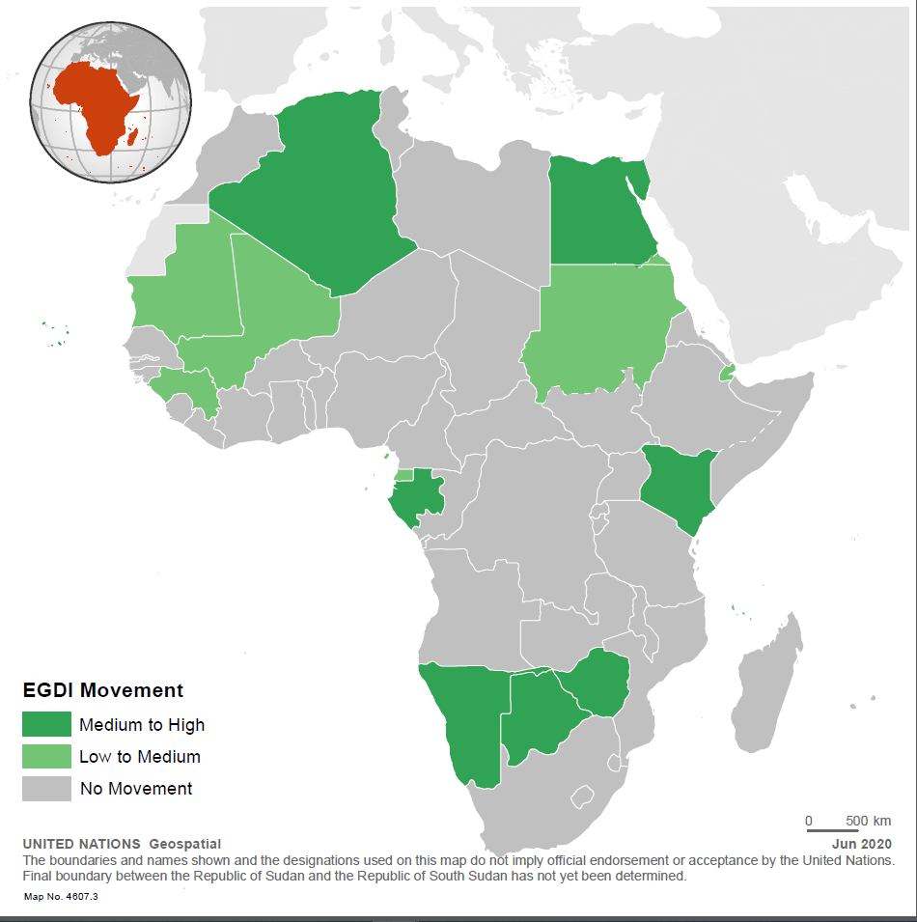
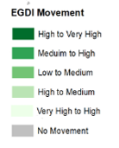
Positive Moves within EGDI Groups
Key Messages
42 MS transitioned from lower to higher levels of EGDI
Africa: 15 countries (28%)
Americas: 9 countries (26%)
Asia: 11 countries (23.%)
Europe: 7 countries (16.%)
Oceania: 0 transitions.

Slide 8
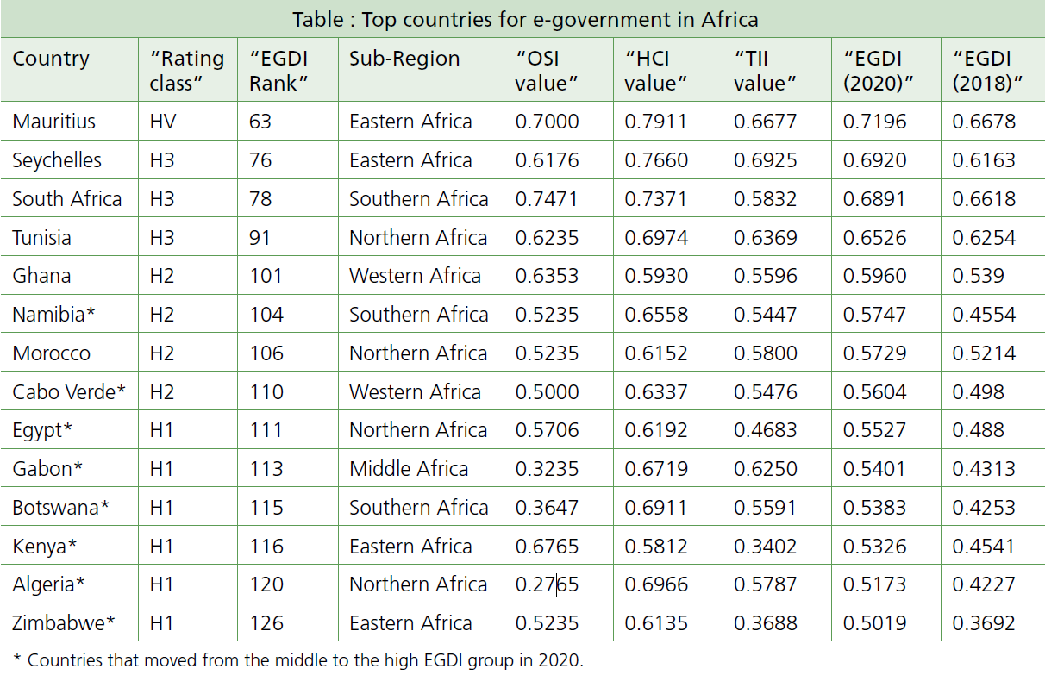
Regional Snapshot: Africa
Key Messages
Largest share of positive changes (15 countries)
8 countries moved from Middle to High-EDGI group (Namibia, Cabo Verde, Egypt, Gabon, Botswana, Kenya, Algeria, and Zimbabwe)
7 countries moved from Low to Middle-EDGI group (Sudan, Mali, Mauritania, Comoros, Djibouti, Guinea, and Equatorial Guinea)
Mauritius, Seychelles and South Africa are the top regional leaders
Yet, Regional EGDI average is the lowest and below the global average
Majority (7 of the 8) of countries in Low-EGDI group are from Africa

Slide 9
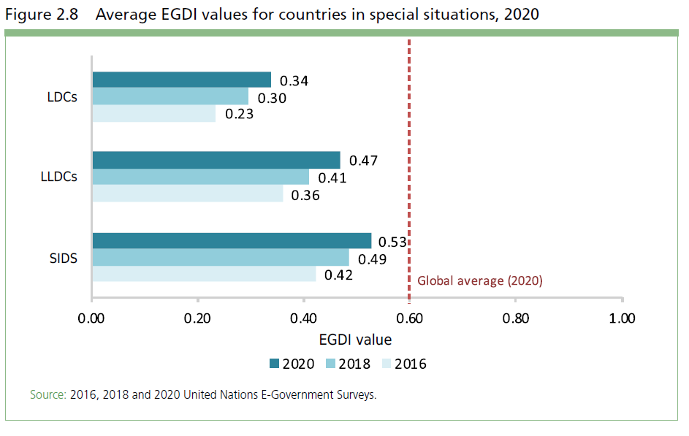
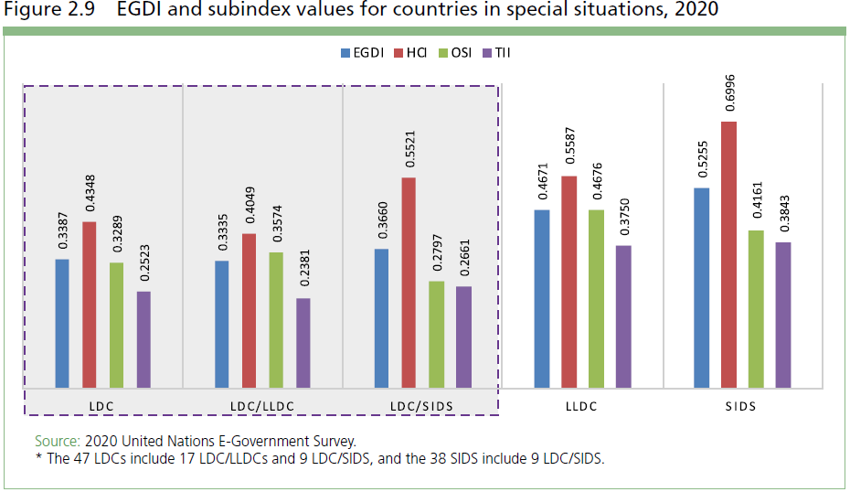
Countries in Special Situation (LDCs, LLDCs, SIDSs)
Key Messages:
Countries in special situation advanced their average EGDI value by 33 % since 2016, which is faster than the world average of 22 per cent.
Still, average EGDI values for LDC, LLDC and SIDS remain well below the world average:
LDCs (0.34)
SIDS (0.47)
LLDCs (0.53)
In Africa:
Out of 54 countries 38 are LDCs, LLDC (including 13 LDC/LLDC), or SIDS (including 3 LDC/SIDS)
Average EGDI for these 38 CSS in Africa is 0.3443
35 of these countries are Low and Lower middle income countries

Slide 10
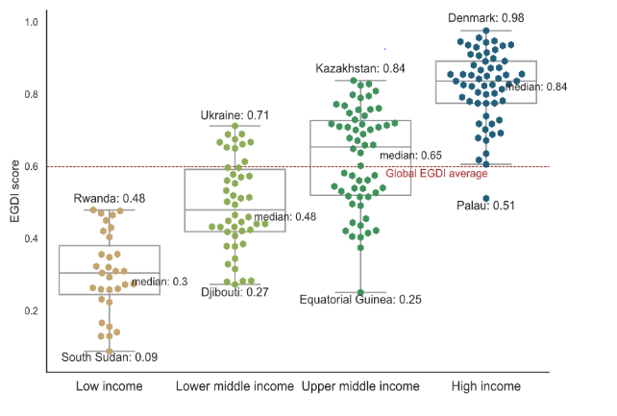
Income levels support, but don’t determine progress
Key Messages:
EGDI levels positively correlate with countries’ income level, but financial resources are not the only critical factor
OSI level is also important
There is significant progress in OSI in many low or lower-middle income countries
Fastest improvement of EGDI scores since 2018 in the lower-middle income countries group (15%)

Slide 11
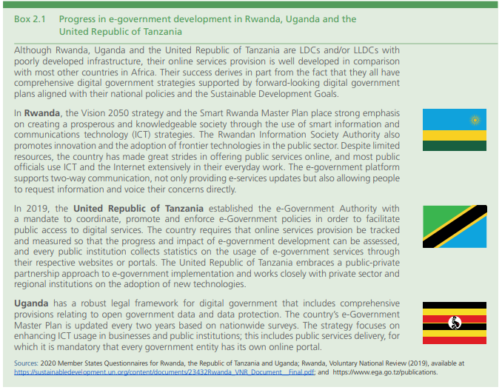
Cases from Africa
Key Messages:
Rwanda, Uganda and Tanzania are LDCs/LLDCs, their OSI is rather well developed.
comprehensive digital government strategies
plans aligned with their national policies and the Sustainable Development Goals.
(e.g. Rwanda’s Vision 2050 strategy and the Smart Rwanda Master Plan)
Uganda has a robust legal framework for digital government that includes comprehensive
Tanzania established the e-Government Authority with a mandate to coordinate, promote and enforce e-Government policies provisions relating to open government data and data protection

Slide 12
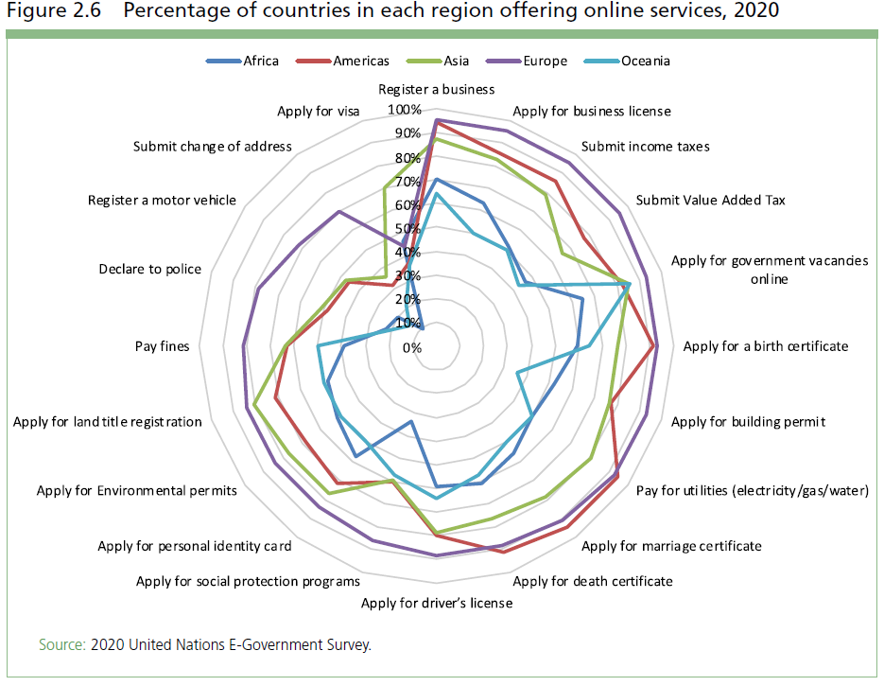
Trends in Transactional Online Services
Key Messages:
Number of countries offering at least one online service increased from 140 to 162 (16%)
84 per cent of the countries offer at least one, and on average 14, out of 20 transactional online services
Europe is the leader in the number of provided e-services (70% of countries provide all 20 online services assessed)
Expansion of online services is moving fast also in other regions:
In Americas and Asia 60% of countries offer 16 out of 20 online services
In Africa and Oceania, 50 per cent of countries offer 12 to 14 online services

Slide 13
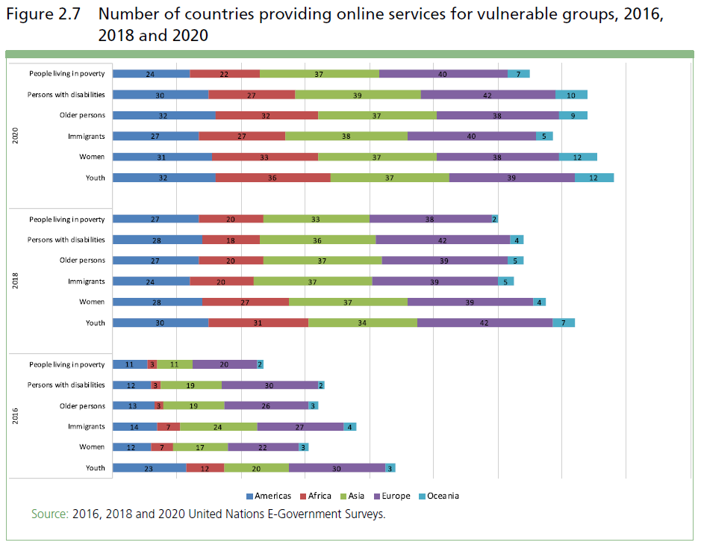
Provision of Online Services to vulnerable groups, (by year and by region)
Key Messages:
80 percent of Member States offer specific services for youth, women, older persons, persons with disabilities, migrants and people living in poverty
However, services for people living in poverty and migrants are offered by fewer countries, which highlights a possible neglect of needs of these groups of people.
European countries continue to lead in online service provision for vulnerable people (93%), followed by Americas (84%), Asia (80%), Oceania (65%) and Africa (55%).

Slide 14
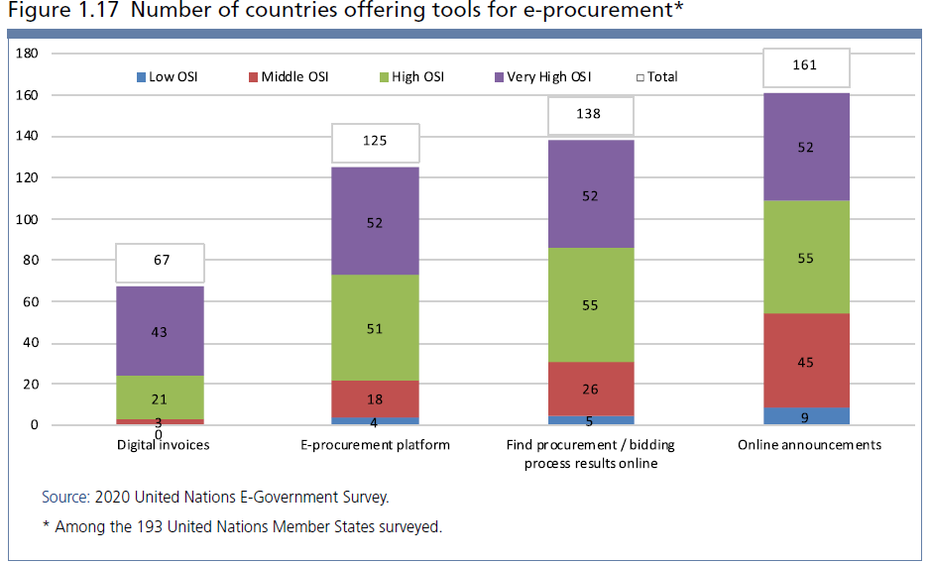
E-Procurement Services Expanded
Key Messages:
161 countries announce gov. procurement
138 provide results of biddings
125 countries have e-procurement portals
67 countries provide digital invoices
Between 62% and 93% of MS in all region have e-procurement portals.

Slide 15
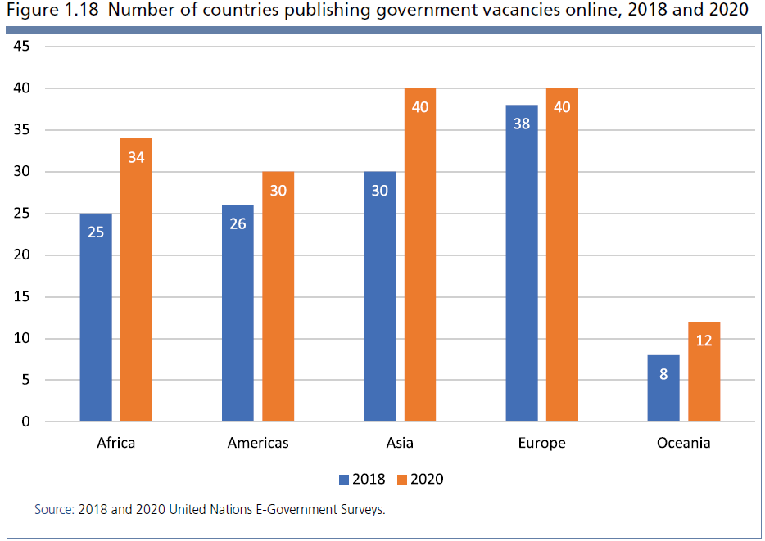
Online Recruitment in Public Sector has increased
Key Messages:
30% more countries publish government vacancies online
93 % of counties in Europe.
36 % of countries in Africa

Slide 16
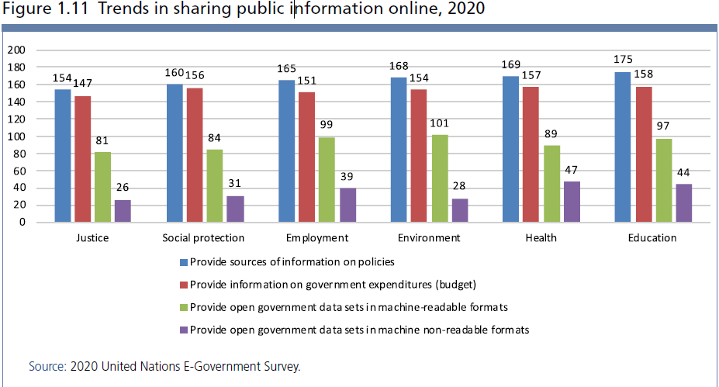
More Public Information is Shared online
Key Messages:
80-90% of UN Member States share information online
50% increase in the number of OGD portals providing sector specific information in machine readable formats
A positive shift from non machine-readable formats (such as PDF) to machine-readable formats

Slide 17
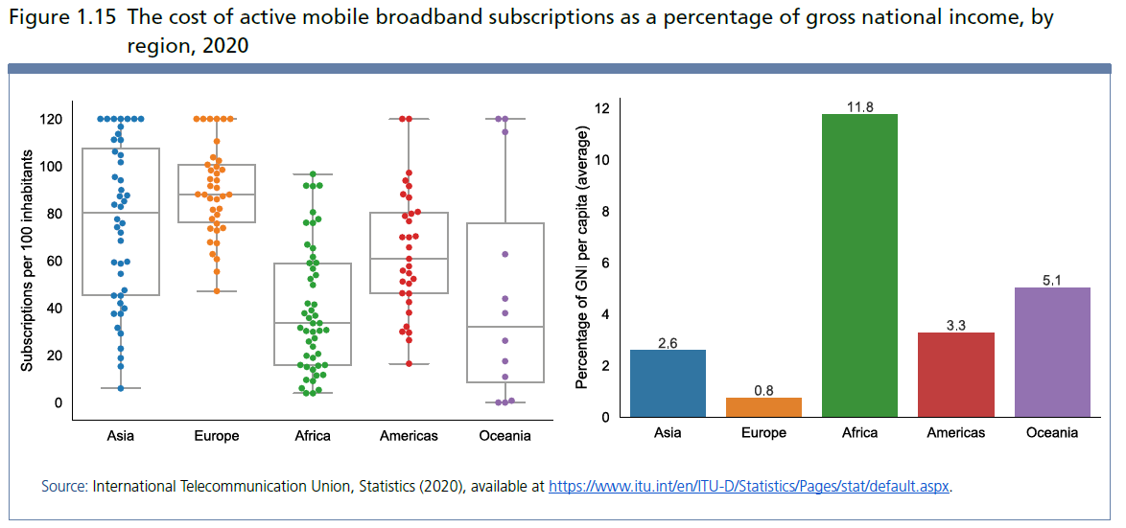
Affordability of Mobile Broadband remains an issue
Key Messages:
Mobile broadband subscription (as a percentage of Gross National Income (GNI) per capita) remains significantly higher in Africa (11.8) and Oceania (5.1)

Slide 18
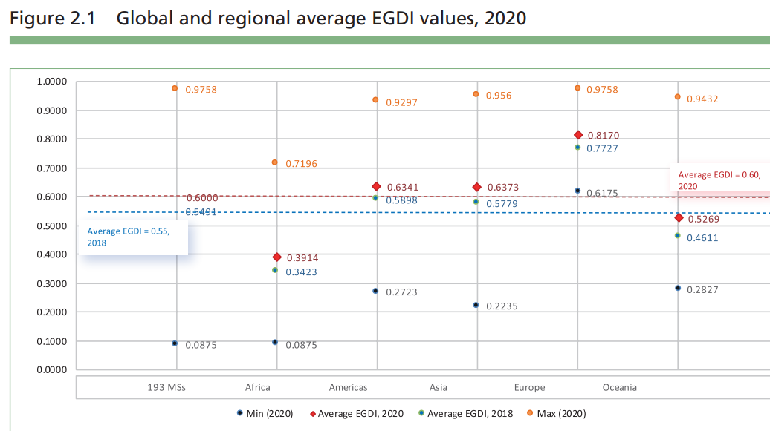
Digital Divide
Key Messages
On average, 66 % of the UN Member States provide online services, however countries offering the full spectrum of services are in the Very-High and High-OSI level groups (93 % and 81 per % respectively)
7 of the 8 countries with the lowest EGDI scores are least developed and/or landlocked countries in Africa
While Africa has made significant progress in e-government development, with only 7 of the region’s 54 countries remaining in the low EGDI group, there is still the persistence of digital divides within and between countries and regions.
Differences in e-government development exist even in highly developed regions
Europe
World Average
Americas
Asia
Oceania
Africa
18

Slide 19
E-Government during COVID-19
The pandemic increased our dependence on digital technologies
A dramatic growth in demand for accelerating digital transformation in the public sector, including in digital government.
All countries shifted their agenda and the priorities of where to focus on digital transformation

Slide 20
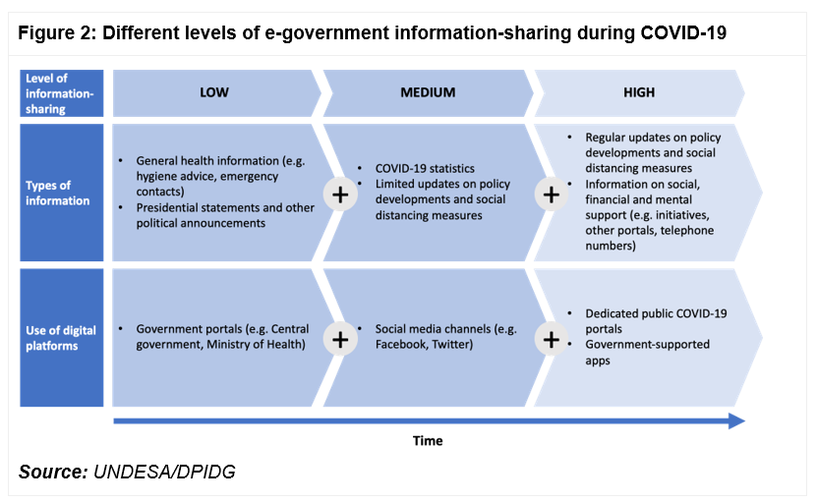
E-Government during the COVID-19 (1/2)
Key Messages
During the crisis, countries focused on providing basic information related to general health precautions and emergency numbers accompanied by public announcements on national portals (low level).
As the crisis intensified, MS began extending their reach and started using more social media channels to report on COVID-19 statistics and provided some limited national policy updates (medium level).
At a later stage in the crisis, more MS started providing regular updates on policy developments and information Some Governments started using dedicated COVID-19 portals to centralize the information (high level).
20

Slide 21
Key Takeaways 1
E-government levels continue to improved globally, including in Africa region
Income levels support, but do not determine progress
Online services provision expanded in all sectors, including for vulnerable groups
E-Procurement Services Expanded
Online Requirement in Public Sector is increasing
Affordability of Mobile Broadband remains an issue, particularly in Africa region
Digital Divides remain

Slide 22
Digital Divides
Africa has made significant progress in e-government development, with only 7 of the region’s 54 countries remaining in the low EGDI group and these are least developed and/or landlocked countries in Africa
On average 66 per cent of the UN Member States provide online services, HOWEVER
most countries offering the full spectrum of 20 services are in the Very-High and High-OSI level groups (93 per cent and 81 per cent respectively)
The majority of Low-OSI countries still offer 1 or 2 online services and only 6 provide between 5 to 9 types of services.
Differences in e-government development exist even in highly developed regions
three small European countries (Andorra, Monaco and San Marino) have highly developed infrastructure and human capital, yet online service provision is at middle-OSI levels (OSI scores ranging from 0.2824 to 0.4824)

Slide 23
Спасибо
Thank You
شكرا
谢谢
Merci
Gracias

