Slide 1
7th Annual APS-HRMnet Conference: 23rd – 25th November 2021
AFRICA PUBLIC SECTOR CAPACITY TO ABSORB THE 4IR SHOCK AND THE ETHICAL IMPLICATIONS

Slide 2
The Industrial Revolution
What characterises the 4IR
Implications of the 4IR
Status of the African Region
Ability for the African Public Sector to absorb the 4IR shock
Ethical Implications
Going forward
Highlights

Slide 3
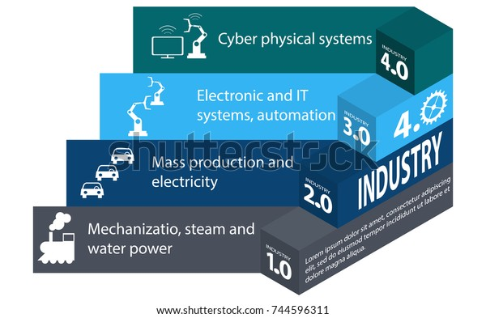
Industrial Revolution: Profound shifts….
Facebook
Twitter
Copy link
Email
Fundamental changes to the way we live, work and relate to one another
Notes:
The 4th Revolution builds on the 3rd revolution digitalisation however the 4IR has more ubiquitous digitalisation and mobile internet. It is characterised by imapct of the digital technologies manifesting with full force through automation and unprecedented events

Slide 4
What characterises the 4IR
Fundamental changes to the way we live, work and relate to one anothe
Increased use of IT gadgets, Mobile devices,
increased demand for processing power, network availability, knowledge access, storage capabilities
Emerging technological innovations e.g robotics, Artifical intelligence, autonomous vehicles, nanotechnology and biotechnology, among others
Profound shifts across all industries, new business models and demand and presentation of new service delivery systems

Slide 5
4IR Calls for a re- shaping and repositioning
New ways of using technology to deliver services
Significant in this revolution is the speed, size and scope!
SPEED: Unfolding at an exponential pace due to the fact that the world is now more of a global village(interconnected) and new technologies exhibit very attractive capabilities
SIZE: Changing not only the how and what, but also the “who we are”
SCOPE: Impacting/transforming all systems across and within countries, and globally in turn
Implications

Slide 6
The complexities of the industrial revolution and the emerging trends on our work, social, cultural, and economic environment globaly call for major transformation.
The transformation must take a global approach or be wholistic to bring on board all the relevent stakeholders ; Public Service Institutions, Private Sector, Civil Society among others
Partnerships; public –private cooperation and partnerships are a MUST
Implications

Slide 7
Where is the Africa Region today?
The 4IR is grounded in digital technologies whose functionality greatly relies on ICT infrastructure.
A glimpse into a few aspects relating to ICT and internet usage in the Africa region as reported by the International Telecommunication Union (ITU) report on ITU Facts and Figure 2020. Key areas cited below

Slide 8
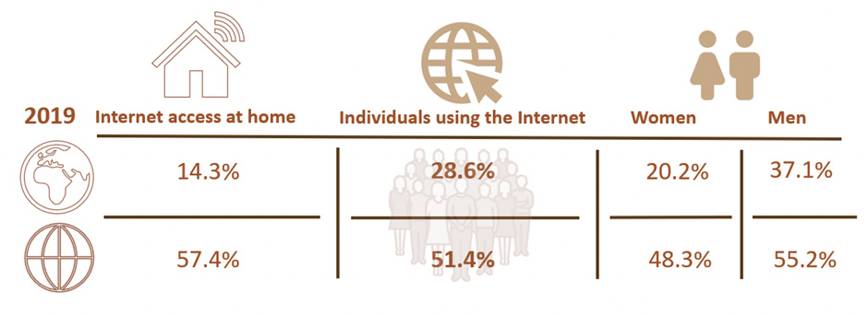
Where is the Africa Region today?
%age of individuals using the Internet by gender, Africa region
Mobile-data prices as a %age of GNI per capita, and monthly data allowance, Africa region, 2019
In terms of affordability the African Region has the highest fixed-broadband basket prices as a percentage of GNI p.c., compared with other regions.
Source: Based on ITU WTI Database
Notes:
NB: WHAT IS IN THE REGION AFFECTS THE PUBLIC SECTOR
Mobile network coverage stands at 88.4 per cent, with 3G network coverage at 77.4 per cent and 4G network coverage at only 44.3 per cent. Internet use by individuals is still below 30 per cent, Internet access at home stands at 14.3 per cent and only 7.7 per cent of households had access to a computer at home

Slide 9
Where is the Africa Region today ?
Mobile network coverage stands at 88.4 per cent, with 3G network coverage at 77.4 per cent and 4G network coverage at only 44.3 per cent.
Internet use still below 30 per cent, indicating a significant usage gap, where individuals who live within the footprint of a network are not using the Internet because of lack of affordability, skills or meaningful/quality access.
75 percent of the world’s population without access to electricity is in sub-Saharan Africa ,
Number of people without access increased, from 33 percent in 2010 to 46 percent in 2019,
NB: the share dropped due to rapid population growth.
On average, Electrification is lagging behind population growth in many countries
Source: “Tracking SDG 7: The Energy Progress Report,” 2021.

Slide 10
Can the Africa Public Sector absorb the 4IR Shock?... Fundamental Requirements
Fundamental to absorbing the industrial revolution shock are the following;
Leadership that understands the changes that this revolution has brought on board and how to strategise for institutional sustainability through innovative and mitigative interventions
Taking the revolution as an opportunity and not a problem to be confronted

Slide 11
Can the Africa Public Sector absorb the 4IR Shock?... Fundamental Requirements
Partnership and collaborations that provide for a wholistic approach to business and aligning stakeholder objectives and expectations
Affordable, accessible and usable internet services
Wide IT infrastructure coverage
Requisite skills: Strategic Thinking, IT and Innovation

Slide 12
Can the Africa Public Sector absorb the 4IR Shock?... Fundamental Requirements
Strategic investment in workforce training approaches: Evaluate, invest, and promote workforce training programs that align with institutional goals, talent practices, skill needs, and culture.

Slide 13
Ethical Implications
Automous technologies with limited human decision making depriving individuals of cognitive capabilities and as such they cease to exercise control over their attention. This is detrimental to innovation as well
While humanness and empathy are going to be fundamental in transforming the public service, the more digital and high tech the world becomes, the less close human relationships get and social connections
Social skills and ability to empathise is reducing

Slide 14
Ethical Implications
Governance Mechanisms that ensure regulation of technologies that will be detrimental to human beings
Generation consumed by social media hence deprived of the art of listening, having human to human contact and ability to read body language. All this affects the humanness in service delivery
A good number of the technolgical innovationa have become a mechnaism for disrupting attention if not well harnessed

Slide 15
Ethical Implications
How do you gurantee confidentiality of automated Information and safety of the owners
Digital divide between those who have no access to automated services viz a viz those who have. The SDG on inclusivity is threatened

Slide 16
Going forward
The values that fundamentally gurauntee inclusiveness, reduce the gap between the rich and the poor and prioritise efficient citizen centred service delivery and create strong public Sector institutions must take centre stage as Africa endeavours to absorb the 4IR shock

Slide 17
Thank you for Listening

